Slide 1


CAPSTONE PROJECT LOST MUSICIANS
CAPSTONE PROJECT LOST MUSICIANS

Slide 2

TABLE OF CONTENTS
01
04
02
05
03
06
Introduction & Business Problem
Results
Data
Discussion
Methodology
Conclusions

Slide 3


O1 Introduction & Business Problem
Being able to express yourself to an audience is important for aspiring musicians. While uploading your tracks to web audience lets you gain publicity, it's just as important to perform live. It might be hard to do if you live in a small city or one without any live music clubs. Analysing foursquare data allows determining what city has the best distribution of music clubs.
An up-and-coming indie music band is looking for a city to move. They decided they will choose one of major Polish cities: Cracow, Poznan, Warsaw or Wroclaw. It's important for them to live in a city where they will have opportunities to play their songs and listen to other fresh music groups.
The city with most music venues and musics stores with best spatial distribution and ratings of facilites will win.

Slide 4


O1 Introduction & Business Problem
Finding the best location for musicians will interest both artists and their audience.
The success criteria of this project is recommending the best of selected cities based on availability of music venues.

Slide 5
O2 Data
Geopy –city coordinates
Foursquare – finding venues and their details

Slide 6
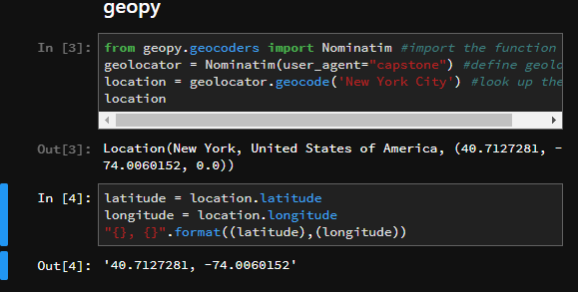
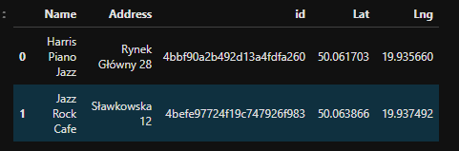
O2 Data
geopy
Foursquare

Slide 7
O3 Methodology
The main objective is to find the city with best music clubs and stores while considering their distribution. In first step information about music-related venues is fetched from FourSquare in each city. Then the venues were clustered by their location - the biggest cluster was considered a representation of a city - the distance within cluster as simplified distribution of the venues and their rating.

Slide 8
O4 Results
Cracow

Slide 9
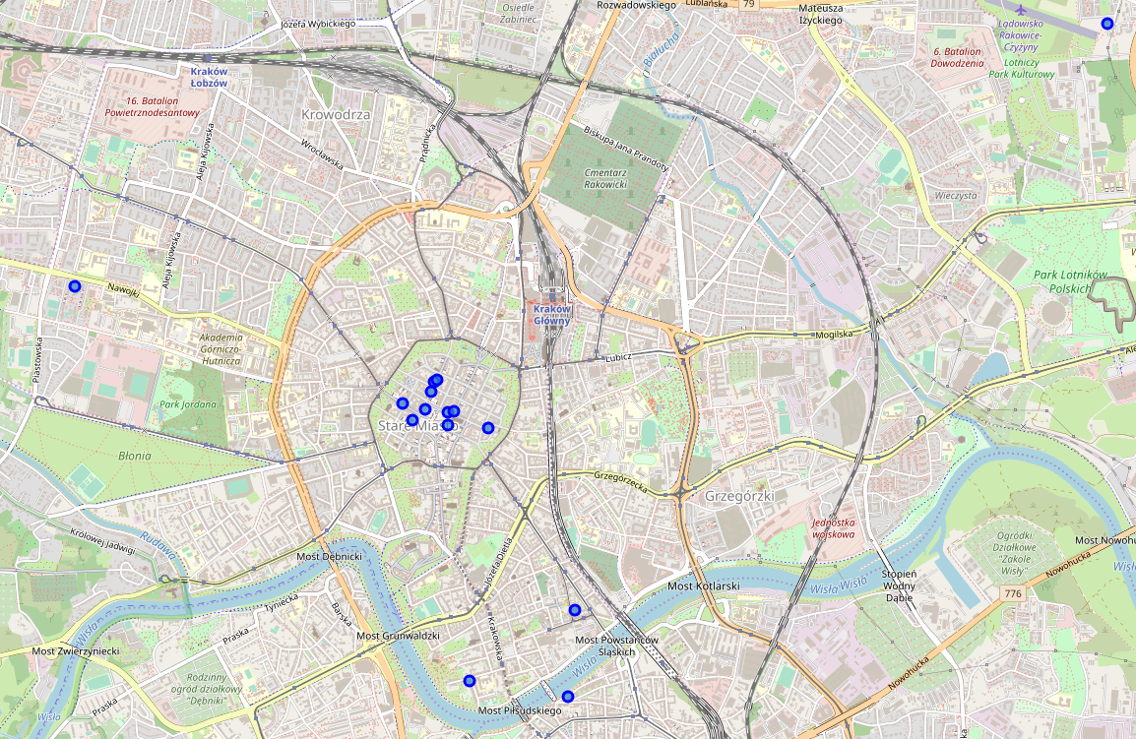
O4 Results Cracow
There are 15 music clubs and stores in Cracow. Most of them are concentrated old town. There are two single outliers - one far east and one east and a group of three venues Podgorze district.

Slide 10
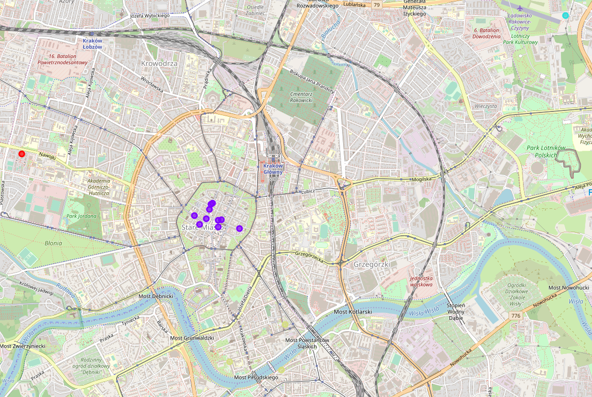
O4 Cracow
Cracow was divided into 4 clusters, with the most populated containing 10 venues.

Slide 11
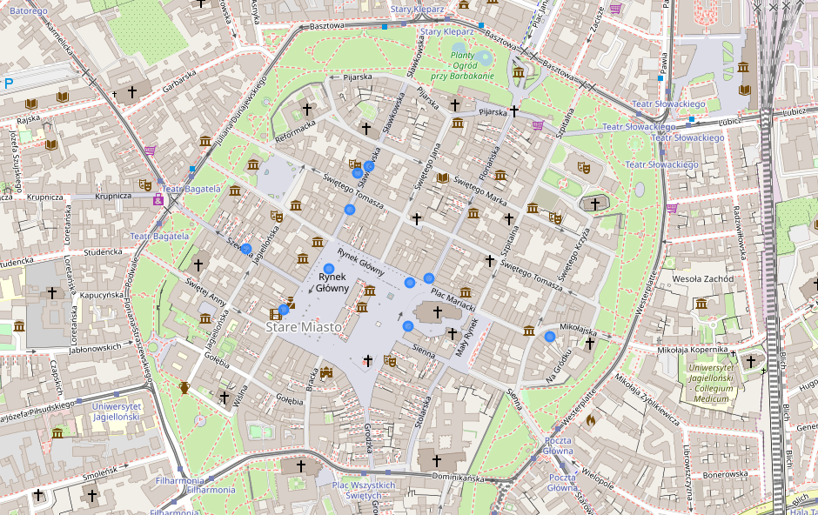
O4 Cracow

Slide 12
O4 Results
Poznan

Slide 13
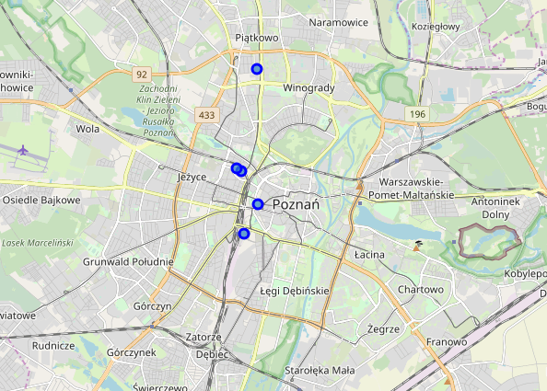
O4 Results Poznan
In Poznan there are 5 venues, distributed roughly around straight line.

Slide 14
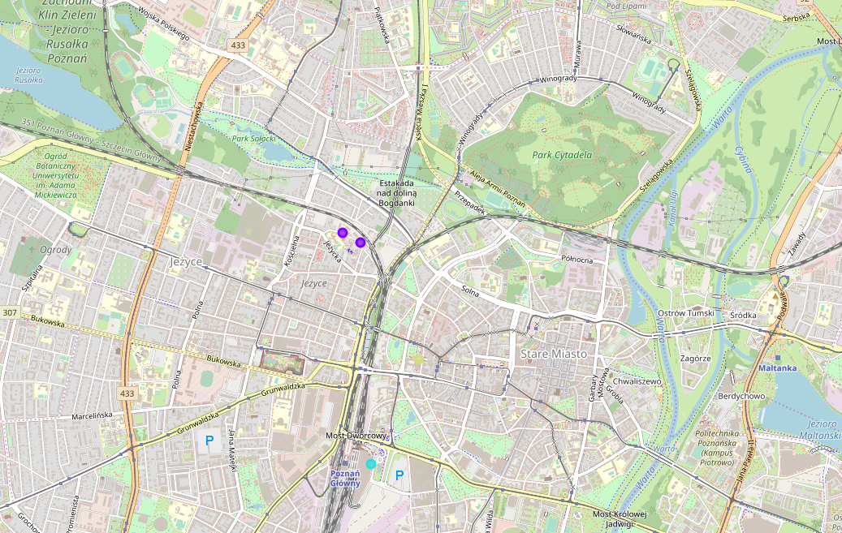
O4 Results Poznan
The winning cluster in Poznan has only 2 venues. At this point it's obvious that Poznan is the worst city for the objective of this project.

Slide 15
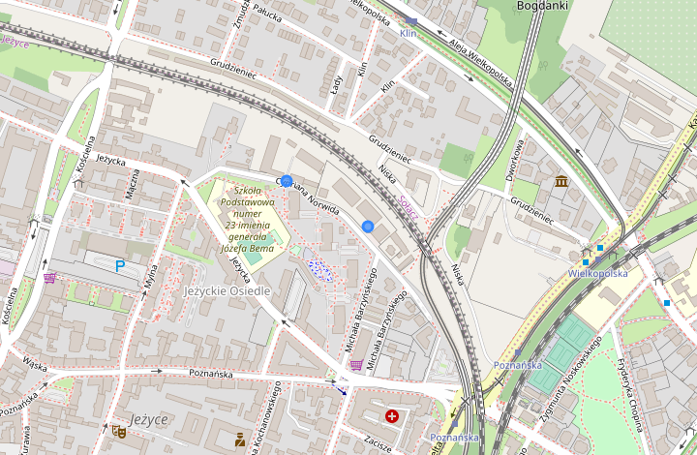
O4 Results Poznan

Slide 16
O4 Results
Warsaw

Slide 17
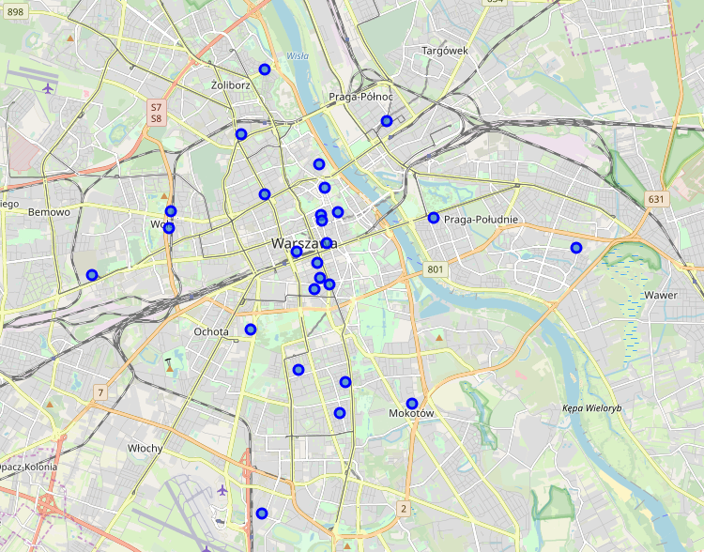
O4 Results Warsaw
There are 26 venues in Warsaw, spread out all over the city in different districts, with majority of them in the city centre.

Slide 18
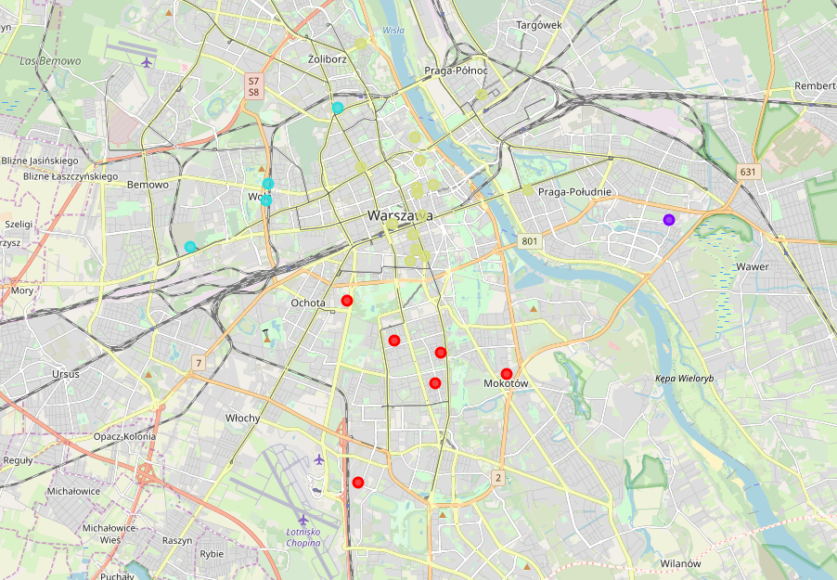
O4 Results Warsaw
The biggest cluster in Warsaw is populated by 15 venues. Warsaw has both most venues overall and when considering the biggest cluster.

Slide 19
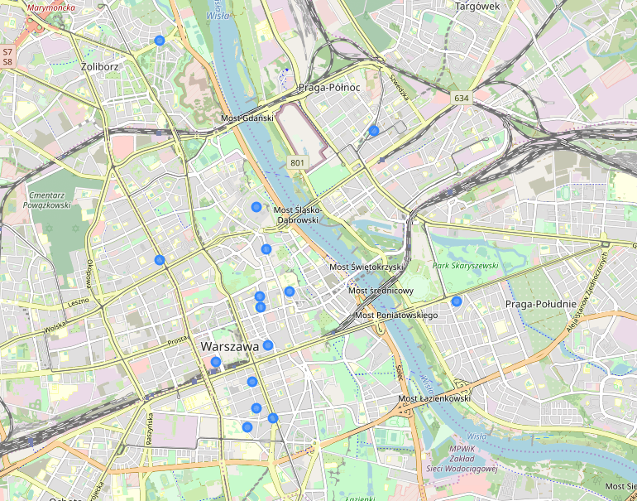
O4 Results Warsaw

Slide 20
O4 Results
Wroclaw

Slide 21
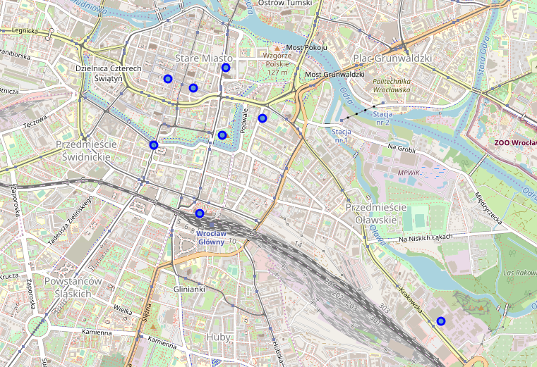
O4 Results Wroclaw
There are 26 venues in Warsaw, spread out all over the city in different districts, with majority of them in the city centre.

Slide 22
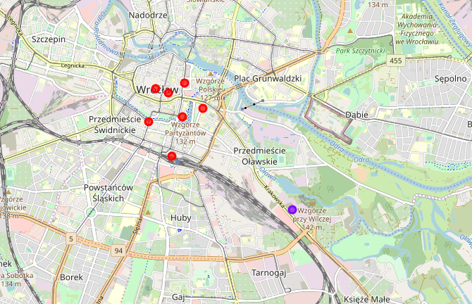
O4 Results Wroclaw
The biggest cluster in Warsaw is populated by 15 venues. Warsaw has both most venues overall and when considering the biggest cluster.

Slide 23
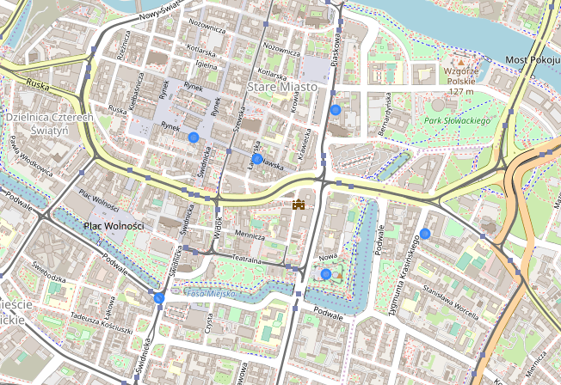
O4 Results Wroclaw

Slide 24
O4 Results Cluster analysis
Distance within clusters
Venue rating in winning clusters
City | Number of venues in biggest cluster | Mean distance
Cracow | 10 | 0.024
Poznan | 2 | 0.021
Warsaw | 15 | 0.059
Wroclaw | 7 | 0.018
 | Cracow | Poznan | Warsaw | Wroclaw
count | 10 | 1 | 5 | 5
mean | 6.89 | 6.8 | 7.32 | 6.88
std | 0.86 | NaN | 0.90 | 0.81
min | 5.8 | 6.8 | 5.8 | 6.1
25% | 6.3 | 6.8 | 7.2 | 6.4
50% | 6.65 | 6.8 | 7.7 | 6.7
75% | 7.775 | 6.8 | 7.9 | 7.0
max | 8.1 | 6.8 | 8.0 | 8.2

Slide 25
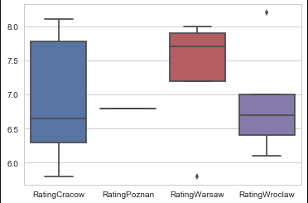
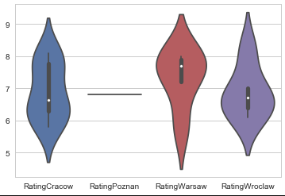
O4 Results Cluster analysis
Box plot
Violin plot

Slide 26
O5 Discussion
Poznan lacks music facilities. Cracow and Wroclaw are similar when considering venues’ location and ratings.
While the biggest cluster in Warsaw had 15 venues, only 5 of them were rated, which may indicate that Cracow is more popular among City Guide users. Further characterization of an average City Guide user is needed for more complex conclusions.
Based on this analysis, Cracow is the best city for up-and-coming music band. There are many music venues – both clubs and stores with good ratings. Secondary choice is Warsaw – it’s the biggest city in Poland with most venues, but due to limited information rating data is uncertain. While free Foursquare API access gives access to vast amounts of data, query limit can be an issue.

Slide 27
O6 Conclusions
The best city for up-and-coming indie music band is Cracow - it has good ammount of quality music clubs and stores and is a popular tourist destination. Close second is Warsaw, thanks to being the biggest city in Poland it has the most venues overall, but not many of them popular among City Guide users.
Wroclaw is a smaller city with less venues, but when considering city centre the results were similar to Cracow.
Poznan is the worst choice - it simply lacks venues.

